Slide 1
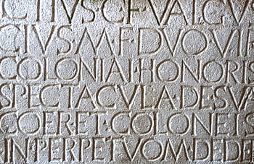
DLT2: Dating Latin Texts with Deep Learning Techniques
~~~~~~~~~~~~
Mitchell Allen and Paul Hoffmann

Slide 2
Many classical texts have been dated with uncertainty, and for some their dates are completely unknown.

Slide 3
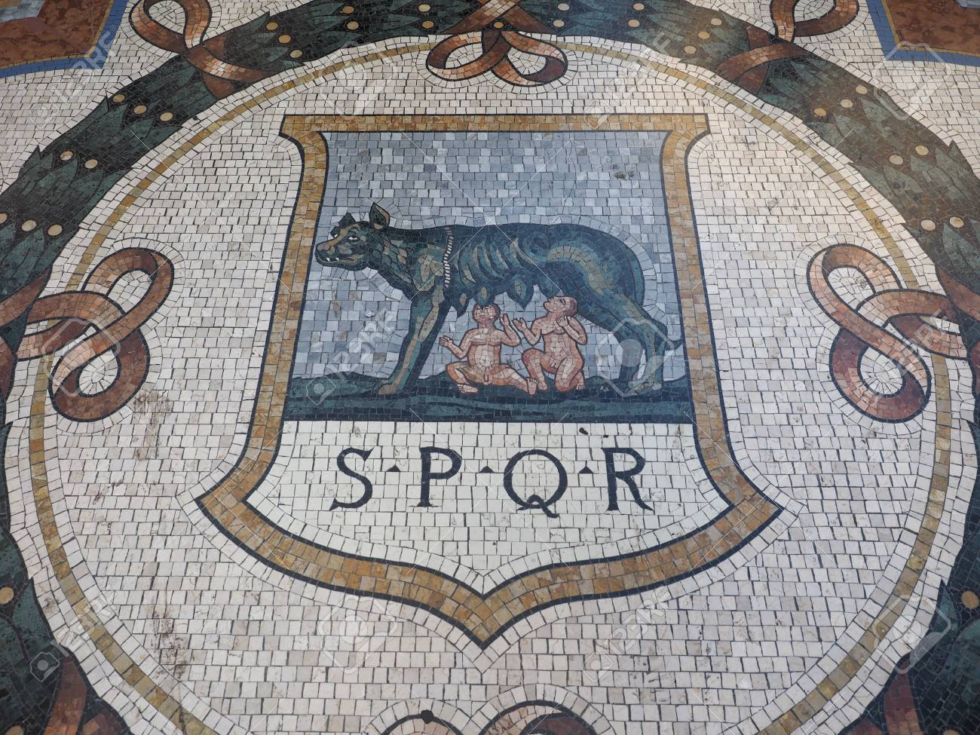
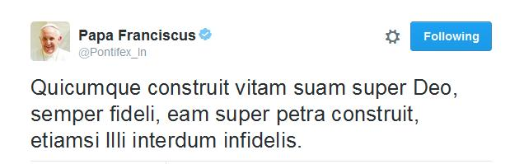
Linguistic Background
Latin is a classical language that was spoken in Rome.
Due to the Roman Empire’s expansion, it spread throughout Europe, as well as parts of Asia and Africa.
Widely employed as the language of international communication until the mid-18th century when it was gradually supplanted by English and French.
Still used today by the Catholic Church.

Slide 4

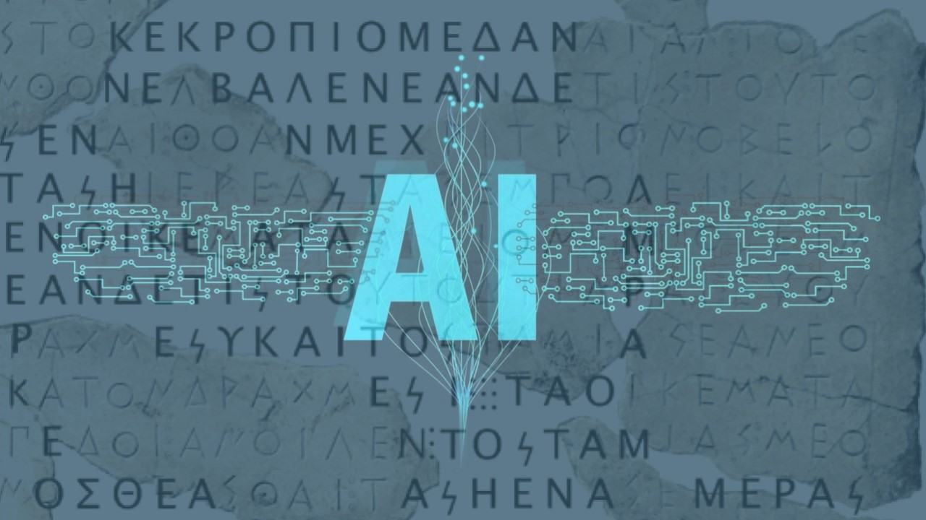
Related Work
As far as we are aware, deep learning has not been used to date Latin texts.
Dating Latin texts usually involves looking for specific words or grammatical features.
There have been several projects using deep learning to date texts in other languages, including Chinese, Sanskrit, and Old English.
Deep Mind’s “Ithaca” for Ancient Greek
Can date texts within 30 years on average
For inscriptions, provides an estimated geolocation
Also restores missing/damaged texts

Slide 5
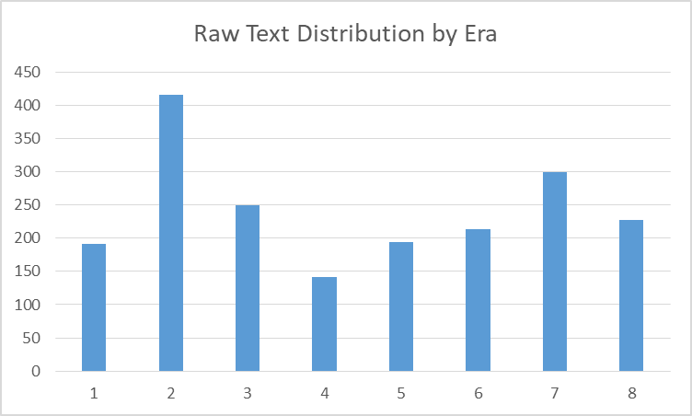
Process: Data
Model trains on a corpus of 1,128 texts
Full corpus is over 2,000 texts, but these are not equally distributed
Downsampling results in 141 texts in each of 8 eras
Texts are divided equally into 8 eras:
Old Latin 700 BC - 75 BC
Caesarean Latin 75 BC - 25 AD
Classical Latin 25 AD - 200 AD
Imperial Latin 200 AD - 400 AD
Late Latin 400 AD - 500 AD
Vulgar Latin 500 AD - 900 AD
Medieval Latin 900 AD - 1300 AD
New Latin 1300 AD - Present

Slide 6
Model
Embedding
Through experimentation with multiple different styles of models and different parameters, we came to the conclusion that a Bidirectional LSTM-Model works best for our purposes.
The Embedding layer uses a Pre-Train Word2Vec of Latin common words
Both Bidirectional LSTM Layers are size 512
The Fully Connected Layer is size 9 (number of categories)
BI
BI
FC

Slide 7
Process: Training
Views first 100 words of a text
Batch size is 32
Trains for 25 epochs
Training scores e.g. accuracy is a lot higher than test scores

Slide 8
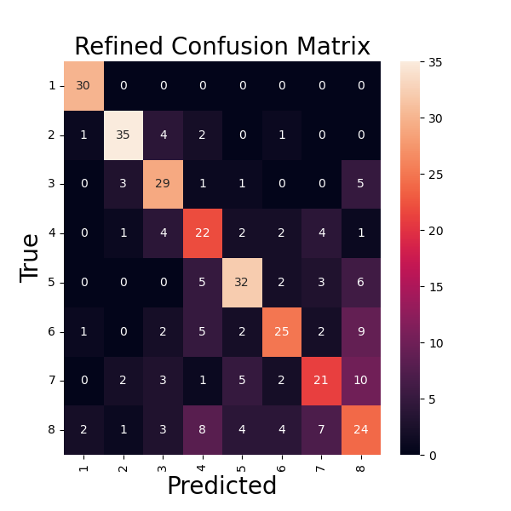
Results
Metrics from our top-performing Bidirectional LSTM model
Test Loss | 1.8099
Test Accuracy | 68.44%
Test f1_Score | 69%
Test Precision | 72%
Test Recall | 66%

Slide 9
Key Takeaways
Classification errors are still clustered more closely to the correct era.
The model seems to experience slight improvements with a smaller word array.
More data would be beneficial, so we plan on upsampling from unused text portions.

Slide 10
Final Paper and Future Work
Upsample data with unused text portions for eras with fewer texts
Increased data would hopefully increase accuracy
Propose narrower time ranges for texts
DeepMind uses 10-year windows
Extend this approach to other less-studied classical languages
Arabic, Syriac, Ge’ez, Assyrian, etc.

Slide 11
Thank you!

